Slide 1
Alpha College of Engg & Tech Khatraj, Gandhinagar EEE(2110005)
1st SEM EE-A Group 5
1 KOTADIA SMIT SATISHKUMAR (130510109034 )
2 BHANUSHALI SHREYABEN DINESHKUMAR (130510109005 )
3 BHAVSAR JAY KANAIYALAL (130510109007 )
4 PATEL AMISHKUMAR MAHENDRABHAI (130510109054 )
5 SHAH YASH VIPUL (130510109111 )
6 PATEL DHRUVKUMAR BHARATBHAI (130510109059 )
Faculty Name:
1 Prof. Narendra C. Mahavadia
2 Mr. Tushit M Desai

Slide 2
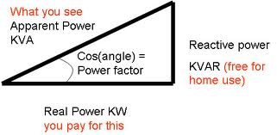
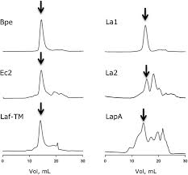
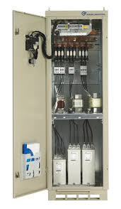
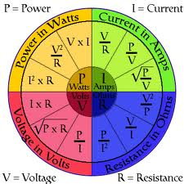
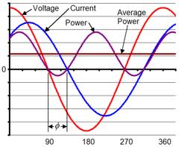
Topic
Power Triangle
Active , Reactive & Apparent power
Method of Power Factor Improvement

Slide 3
Power Triangle
When each component in fig. is multiplied by a voltage V, a Power Triangle is obtained as shown in fig.

Slide 4
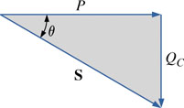
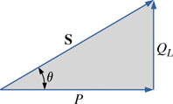
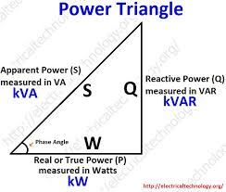
Power diagram for inductive loads.
Power diagram for capacitive loads.

Slide 5
True, reactive, and apparent power
In a simple alternating current (AC) circuit consisting of a source and a linear load, both the current and voltage are sinusoidal. If the load is purely
resistive, the two quantities reverse their polarity at the same time. At every instant the product of voltage and current is positive, indicating that the
direction of energy flow does not reverse. In this case, only real power is transferred.

Slide 6
If the loads are purely reactive, then the voltage and current are 90 degrees out of phase. For half of each cycle, the product of voltage and current is
positive, but on the other half of the cycle, the product is negative, indicating that on average, exactly as much energy flows toward the load as flows
back. There is no net energy flow over one cycle. In this case, only reactive energy flows—there is no net transfer of energy to the load.
Practical loads have resistance, inductance, and capacitance, so both real and reactive power will flow to real loads. Power engineers measure apparent
power as the magnitude of the vector sum of real and reactive power. Apparent power is the product of the root-mean-square of voltage and current.

Slide 7
Conventionally, capacitors are considered to generate reactive power and inductors to consume it. If a capacitor and an inductor are placed in parallel,
then the currents flowing through the inductor and the capacitor tend to cancel rather than add. This is the fundamental mechanism for controlling the
power factor in electric power transmission; capacitors (or inductors) are inserted in a circuit to partially cancel reactive power 'consumed' by the load.

Slide 8
True power, P, or active power: watt (W)
Reactive power, Q: volt-ampere reactive (var)
Apparent power, |S|: the magnitude of complex power S: volt-ampere (VA)
Phase of voltage relative to current, φ: the angle of difference (in degrees) between voltage and current; current lagging voltage (quadrant I vector), current leading voltage (quadrant IV vector)
S
Q
P

Slide 9
Active Power
Instantaneous power to a load is p = v • i
In an ac circuit
p may be positive sometimes and negative other times
Average value of the power, P
Real power
Average value of instantaneous power, real power, active power, and average power mean the same thing

Slide 10
Reactive Power
During times when p is negative, power is being returned from load
This can happen for inductive or capacitive loads
Power that flows into these loads and back out is called the reactive power
Average value of reactive power is zero

Slide 11
Active and Reactive Power Equations
P = VI cos θ = S cos θ
Q = VI sin θ = S sin θ
V and I are RMS values
θ is the phase angle between V and I
Q is positive for inductive circuits and negative for capacitive circuits

Slide 12
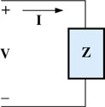
Apparent Power
Power to a load is VI
If load has both resistance and reactance
Product is neither the real power nor the reactive power, but a combination of both
This is called the apparent power, S
S = VI = I²Z = V²/Z
Units are volt-amperes (VA)
Defining the apparent power to a load.

Slide 13
Power Factor Improvement

Slide 16
Ratio of real power to apparent power is called the power factor, F_{p}
It's a practical measure of the efficiency of a power distribution
system. For two systems transmitting the same amount of real power, the system with the lower power factor will have higher circulating currents due to
energy that returns to the source from energy storage in the load. These higher currents produce higher losses and reduce overall transmission efficiency.
A lower power factor circuit will have a higher apparent power and higher losses for the same amount of real power.

Slide 17
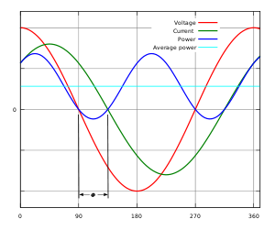
energy that returns to the source from energy storage in the load. These higher currents produce higher losses and reduce overall transmission efficiency.
A lower power factor circuit will have a higher apparent power and higher losses for the same amount of real power.

Slide 18
F_{p} = P/S = cos θ
Angle θ is angle between voltage and current
For pure resistance θ = 0°
For inductance, θ = 90°
For capacitance, θ = -90°
For a circuit containing a mixture, θ is somewhere between 0° and ±90°
Demonstrating the impact of a capacitive element on the power factor of a network.

Slide 19
Unity power factor
For a purely resistive circuit, the power factor will be one
For load containing resistance and inductance
Power factor will be less than one and lagging
Current lags the voltage
The power factor is unity (one) when the voltage and current are in phase. It is zero when the current leads or lags the voltage by 90 degrees. Power
factors are usually stated as "leading" or "lagging" to show the sign of the phase angle of current with respect to voltage.

Slide 20
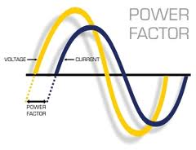

Slide 21
THANK YOU.

